Slide 1

https://www.uni-goettingen.de/en/48115.html
UNPLAB-QuGen_Ch-5[GenMeanAnal]
Quantitative Genetics. Components of Genetic Variation.
Models for the Genotypic Value – here: Heterosis and Generation Means Analysis
1

Slide 2
Sequential Number: #39
UNPLAB-QuGen_Ch-5[GenMeanAnal]
Unless I explicitly state otherwise, images and cartoons are created using ChatGPT.
You may use this material free of charge under the terms of the CC BY license. This requires that you provide appropriate attribution to the author:
W. Link, University of Goettingen, Germany.
In a few cases, individual images, photographs, or similar material may be subject to a more restrictive Creative Commons license. Where this applies, it is explicitly indicated, and you must comply with the stated license terms for those items.
Please check the license information carefully before reuse. Responsibility for complying with the applicable license terms rests entirely with you.
2

Slide 3
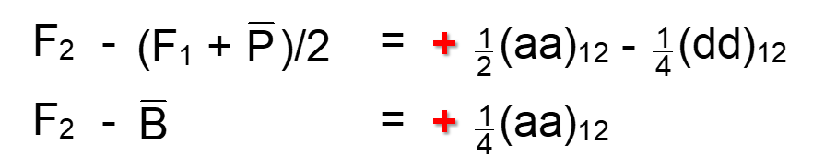
You already know: A lot. 38 Chapters of UNPLAB is a lot.
Keywords of this chapter:
Diversity vs. Variance; Normal Distribution and Variance; More than one trait to breed for; Qualitative vs. quantitative variation aka monogenic vs. polygenic variance; Impact of allele frequencies on variance, aka impact of selection of variance. You have seen the transition from monogenic to polygenic Segregation and Variance. The parameters of the Metric F∞ Model, mainly the additive effect ‘a’ and the dominance effect ‘d’
Algebra as introduced in this chapter:
F1 – = d₁ + d₂ – (aa)₁₂ + (dd)₁₂
3

Slide 4
Heterosis: Difference in trait expression F1 vs. mean of the homozygous parents”. Here: Simplest-&-most popular-common genetic explanation. Cf: UNPLAB-BrMeth_Ch-2[Heterosis]
Parent 1
Parent 2
F1-hybrid
See genotypes at 20 loci, homozygous for the parents and, at ten loci, heterozygous in F1. Black is ‚favourable-&-dominant‘ (such as black=AA and white=aa).
All loci have same effect, same gene action. No Epistasis.
Impact per locus is 1 if black and 0 if white. Per locus,
additive effect is a = 0.5
dominance effect is d = 0.5.
c=0.5 per locus; c=20∙0.5=10 for the trait (20 loci).
Parent 1 performs: G(P1) = c + 10∙a + 10∙(-a) = 10
Parent 2 performs: G(P1) = c + 12∙a + 8∙(-a) = 12
Parental mean G-value: = c + 11∙a + 9∙(-a) = 11
F1-hybrid G-value: = c + 6∙a + 4∙(-a) + 10∙d=16
Superiority of F1 over Parental mean is:
[c + 2∙a] minus [c + 2∙a + 10∙d]
… this is 10∙d. This superiority is the heterosis here.
Heterosis here is the sum of the d-effects of the 10 heterozygous loci (10∙d = 5); 16 – 11 = 5.
10 [units]
12 [units]
16 [units]
4

Slide 5
Heterosis: Difference in trait expression between F1 and mean of the homozygous parents. Here: Its simplest-&-most popular-common genetic explanation.
Parent 1
Parent 2
F1-hybrid
The diagram may be read as genotypes at 20 loci, homozygous for the parents and, if the parents differ, heterozygous in F1. Black is ‚favourable-&-dominant‘.
The impact per locus is 1 [trait unit] if black. If a genotype was at all 20 loci at least heterozygously black, then it has the theoretically highest trait value; then its perfor-mance would be 20 [units]. Here, parent 1 performs [10], parent 2 performs [12], their F1 has [16], thus, heterosis is 16-11 = 5 [units]. Heterosis; you see ‘how come’ ;-)
If this genetic explanation of Heterosis was true, then …
We need parents which are as good (as ‘black’) as possible
We need parents which complement each other (are different from each other) as much as possible.
It is overly simplistic to give each locus the same contribution to the trait. Yet, it illustrates how the model works. ISBN 0-89118-549-6
10 [units]
12 [units]
16 [units]
5

Slide 6
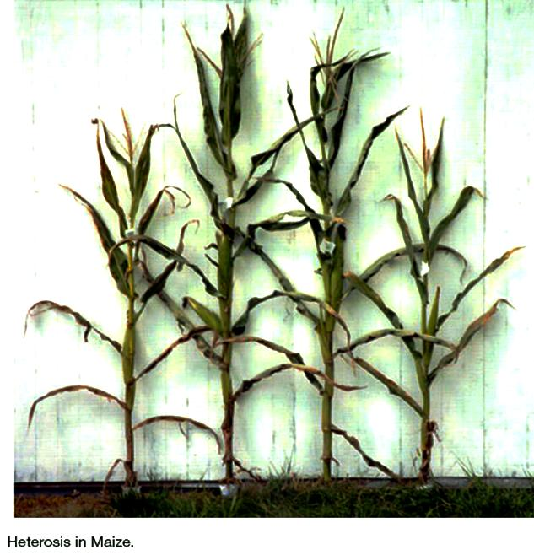
DOI:10.13140/RG.2.2.17230.05440
Heterosis.
What a phenomenon!
The hybrid (F1) performs higher than the mean of its inbred parents (P), although the hybrid has no ‘better’ genes than what was inherited from its parents; and although the environment is the same.
Same time, same soil, same sun, same precipitation, same anything.
Yet: More yield.
https://s.gwdg.de/LQAu7K
P1
F1
F1
P2
6

Slide 7

Heterosis is an exception from the rule that offspring is similar to the parents. If parents are fully inbred yet unrelated, then their F1 offspring is more vigorous and hence different from them in many aspects.
The effect of Heterosis looks somewhat similar as the effect of better irrigation and/or better mineral fertilization. It looks similar as if the hybrid plants were ‚doped‘.
Miracle- or wonder-tomato
7

Slide 8
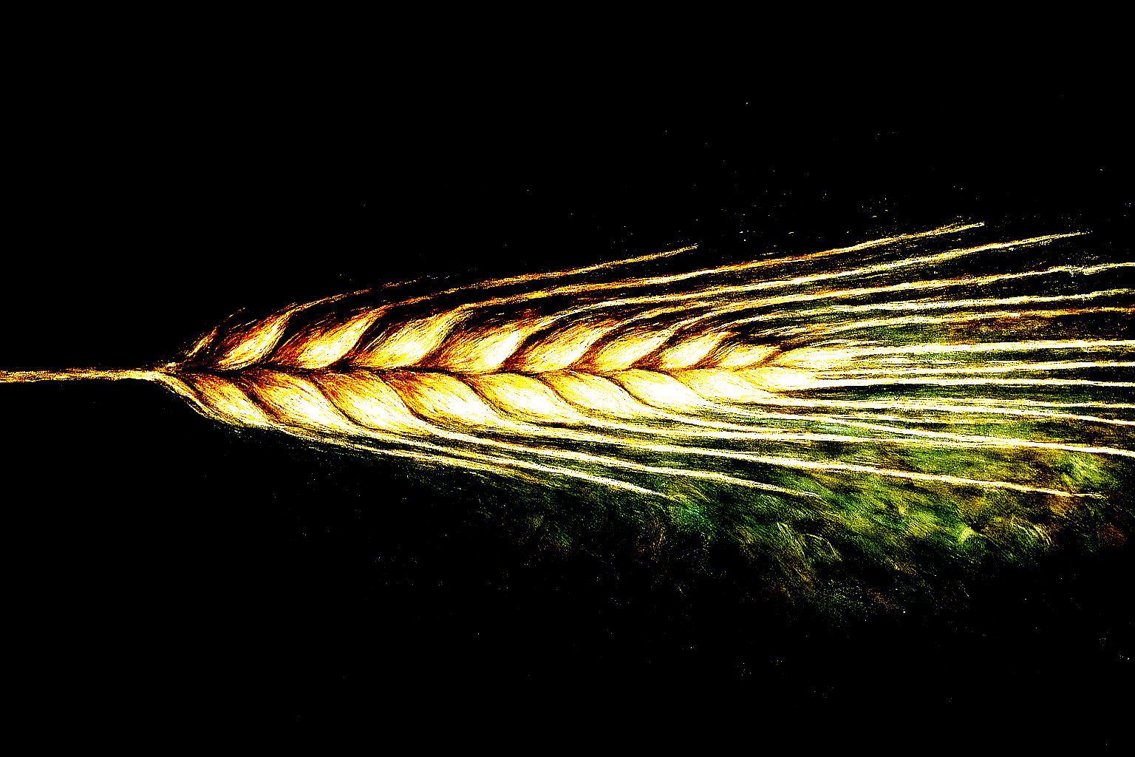

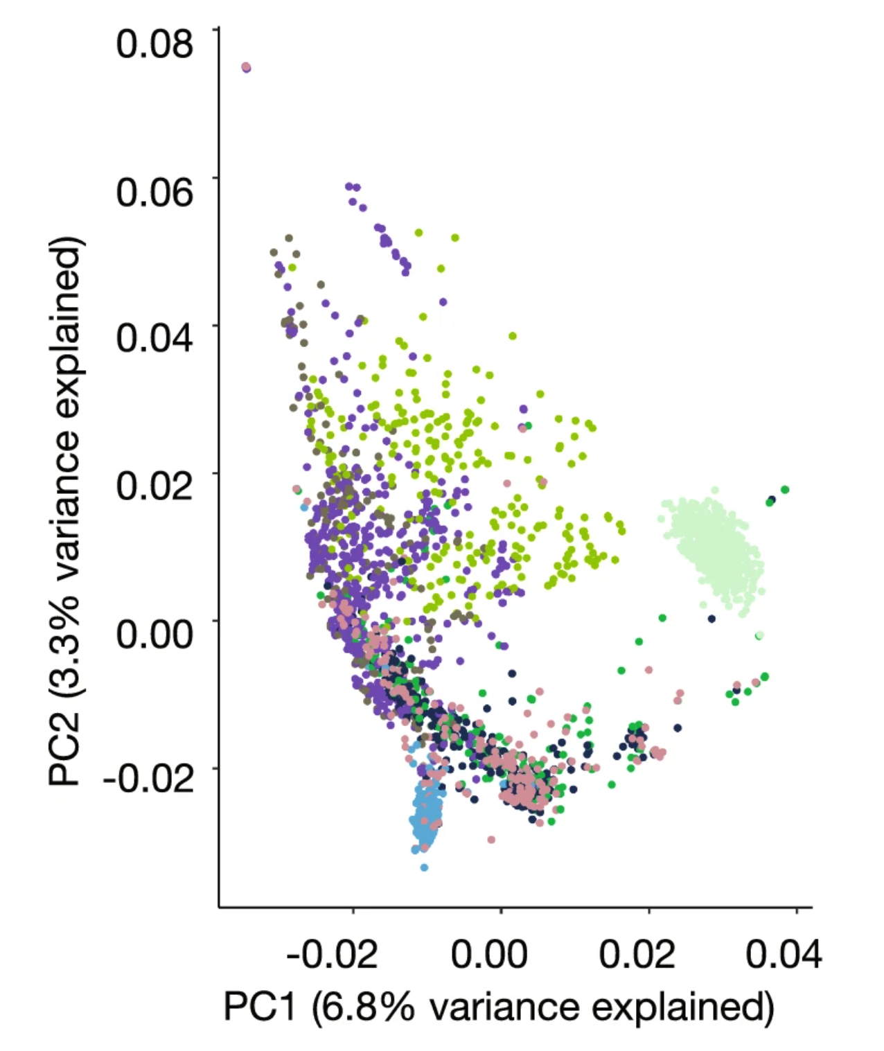
Heterosis. General “Rules”
1
Heterosis exists normally for all quantitative traits (except traits like %-content of a compound, e.g. seed protein content).
2
Heterosis is usually smaller in self-fertilizing crops (barley) than in cross-fertilizing crops (rye).
3
Heterosis is usually larger in traits that are connected with fitness (grain yield, number of ears per plant) than in other traits such as morphology
(plant height, leaflet width) or quality (seed protein content).
4 Heterosis is usually the larger the more the parents differ genetically from each other (the less genetically related they are).
8
DOI 10.1007/s00122-023-04360-8

Slide 9
Heterosis. The same conclusions accrue if dominance is only partial and if loci differ in their contribution to the trait. Yet, ‘good’ must be least partially dominant here.
Green area: Six loci are favourably homozygous in both parents: Breeding can not improve anything here. Blue: 10 loci which are complementary between the parents, making the hybrid hetero-zyous. Hence, the hybrid shows ‚good‘ genetics at six plus ten, which makes 16 good loci (which gives 16 [units] as performance).
There are four further loci with none of the two parents having the good allele. Find some other parent 2, more complementary to parent 1. Since parent 1 is ‚bad‘ at ten loci, such maximum-com-plementary parent 2 needs to be ‚good‘ only there, it would in such case perform [10] (not better than parent 1). F1 would perform 20, with 14 heterozygous loci; no locus homozygous ‘white’ in F1.
It is easier to find a good F1-hybrid if both parents are very good, have few homozygous-’white’ loci (need only complement each other at few loci). It is a conflict to search for parents which are both ‚elite‘ and nevertheless complement each other, hence, are different from each other. If both are elite, they can probably not be very different from each other.
Note that the hybrid has not more ‚black‘ alleles (22) than the sum of ‚black‘ alleles in female (10) and male (12) gamete that made it.
Parent 1
Parent 2
F1-hybrid
10 [units]
12 [units]
16 [units]
9
9

Slide 10
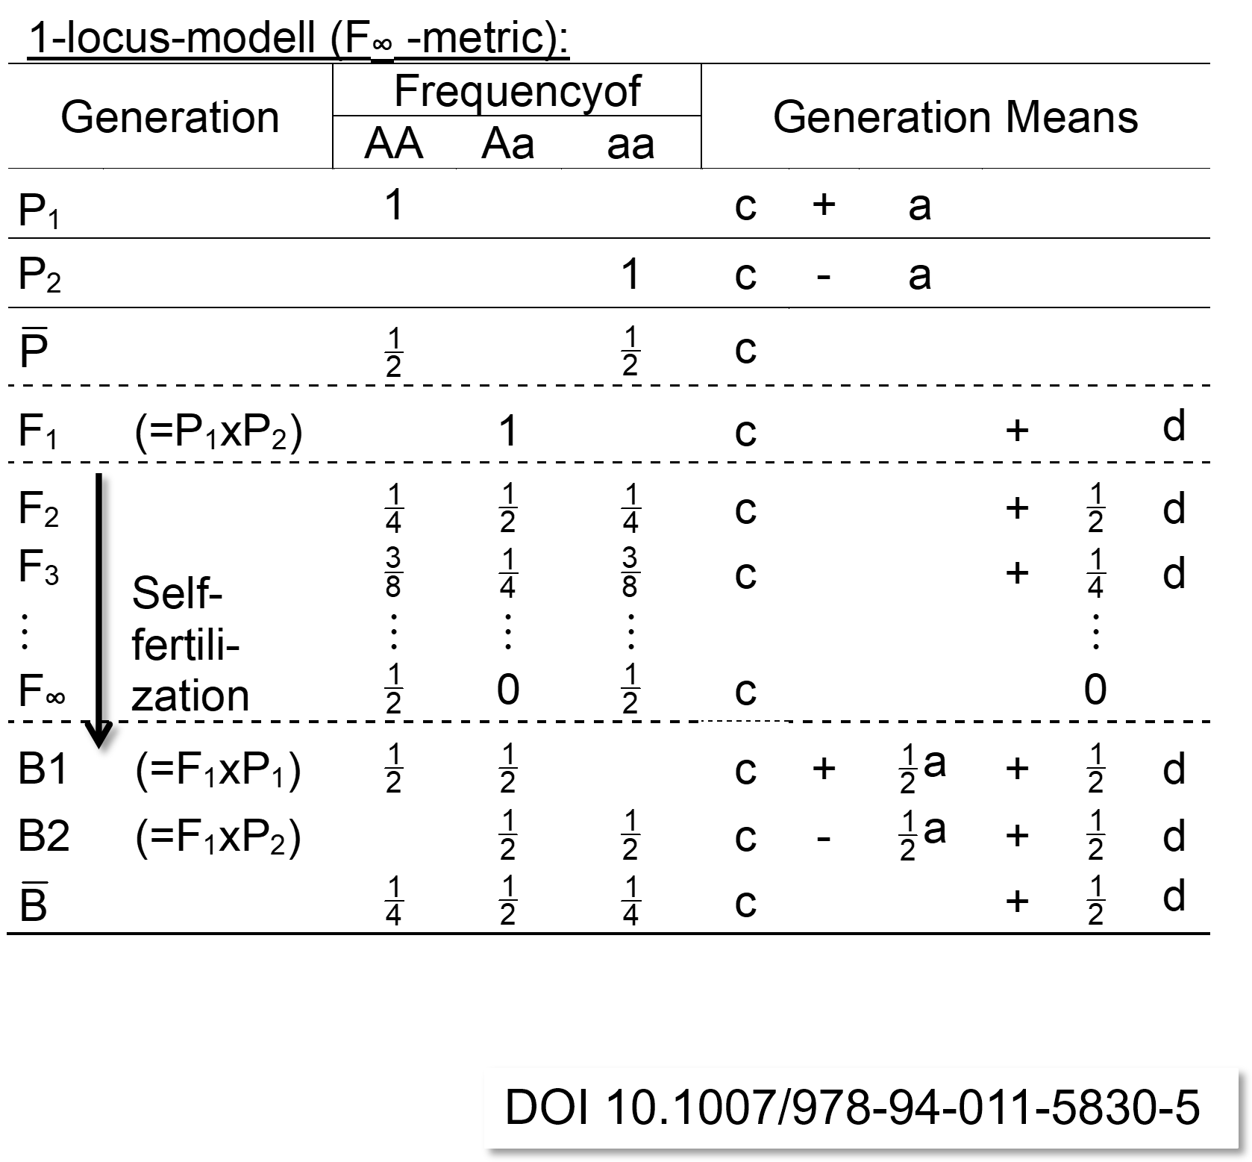
Generations Means Analyses. Averages (across individuals of given generation) such as F1, F2 etc. from crossing two pure lines are given: A ‘Mendelian’ cross.
The probably most important reason for the metric model of the genotypic value is the rôle of these parameters when defining the parameters of the statistical model. The statistical model leads directly to quantitative values for genetic similarities among relatives and hence to quantities about expected gains from selection.
Nevertheless: Here is an application of the metric model: The so-called ‚Generation Means Analyses‘. It is based on bi-parental, Mendelian crosses, where allele frequen-cies are p=q=0.5 (if not p=0 or p=1); both parents contri-bute equally to the (non-selected) offspring generations.
The here-analyzed generations are: Parents, F1, F2 (via selfing the F1 with very many F2 individuals hence zero Drift; and no Selection). Further generations are F3 (no Drift no Selection), F4; et cetera, all from selfing. More-over, the Backcrosses towards P1 and towards P2 (B1; B2). More generations could be included in such Generations Means Analyses.
Cf. UNPLAB-PopGen_Ch-3[Inbreeding]
DOI 10.1007/978-94-011-5830-5
10

Slide 11
Generations Means Analyses. Averages (across individuals of given generation) such as F1, F2 etc. from crossing two pure lines are given: A ‘Mendelian’ cross.
Based on one locus, the mean of the two homozygous parents is c; remember our definition of c; hence, the monogenic value of the F1-generation is F₁ = c + d.
The mean of all F₂ individuals (p=q=0.5) is hence c + ½ d.
The ‚+a‘ contribution of the AA genotypes and the ‚-a‘ contribution of the aa genotypes in F₂ cancel each other out. The mean of the F₃ generation thus is c + ¼ d.
The mean of the F∞ generation thus is c. This looks simple and dull, yet it is important. If there was no Selection-Drift-Mutation, then the ultimate homozygous, segregating ‚bulk of lines‘ aka RIL* population from cross between two homozygotes is expectedly showing the same (here monogenic) trait expression as was al-ready seen as means of the parents. The same applies for the DH-generation.
Why shall we cross and allow the segregation and make homo-zygous again if, finally, we arrive at the same average value that was already available at the start of the entire endeavour?
*Recombinant Inbred Lines population aka F∞
11

Slide 12
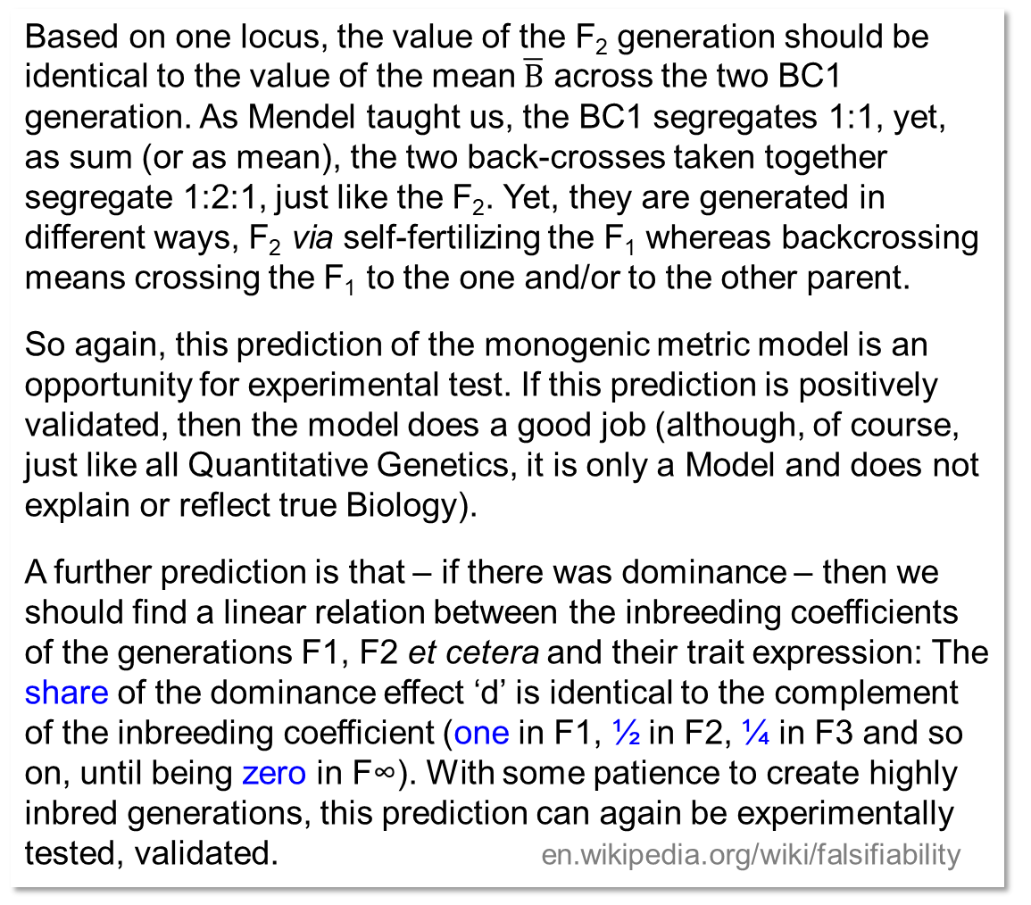
The Generations Means Analyses allows testable predictions. Nice; ‘awesome’. ☺ ☺ ☺
12
Based on one locus, the value of the F₂ generation should be identical to the value of the mean $\overline{B}$ across the two BC1 generation. As Mendel taught us, the BC1 segregates 1:1, yet, as sum (or as mean), the two back-crosses taken together segregate 1:2:1, just like the F₂. Yet, they are generated in different ways, F₂ via self-fertilizing the F₁ whereas backcrossing means crossing the F₁ to the one and/or to the other parent.
So again, this prediction of the monogenic metric model is an opportunity for experimental test. If this prediction is positively validated, then the model does a good job (although, of course, just like all Quantitative Genetics, it is only a Model and does not explain or reflect true Biology).
A further prediction is that – if there was dominance – then we should find a linear relation between the inbreeding coefficients of the generations F1, F2 et cetera and their trait expression: The share of the dominance effect ‘d’ is identical to the complement of the inbreeding coefficient (one in F1, ½ in F2, ¼ in F3 and so on, until being zero in F∞). With some patience to create highly inbred generations, this prediction can again be experimentally tested, validated. en.wikipedia.org/wiki/falsifiability

Slide 13
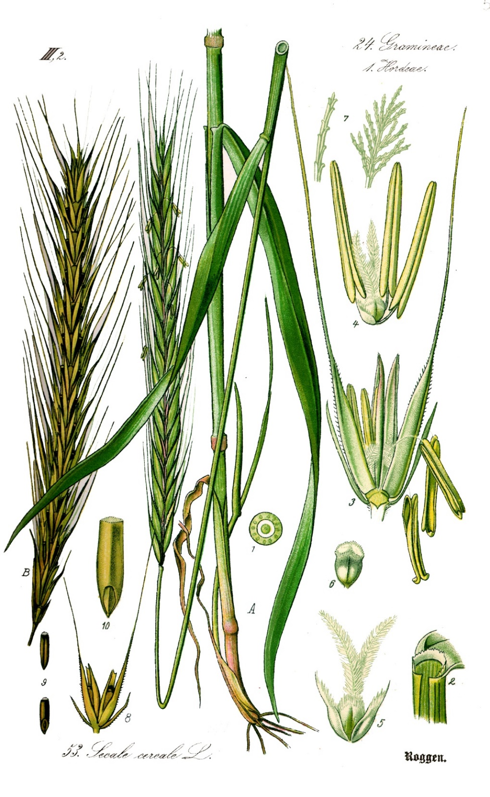
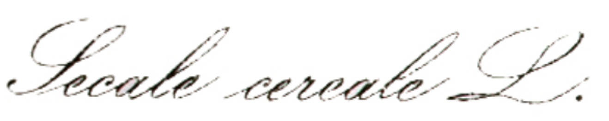
Let us come to something ‚real‘; to data from the real world.
Data on plant height in winter rye, Secale cereal L.
Rye is a cross-fertilizing species. To discuss Heterosis in the frame of Generations Means Analysis, it is more appropriate to chose such outcrossing plant than a selfing plant such as wheat or barley (because heterosis and inbreeding depression is typically small in the latter).
Thomé, W.O., 1885 .Flora von Deutschland, Österreich und der Schweiz 1885, Gera.
13

Slide 14
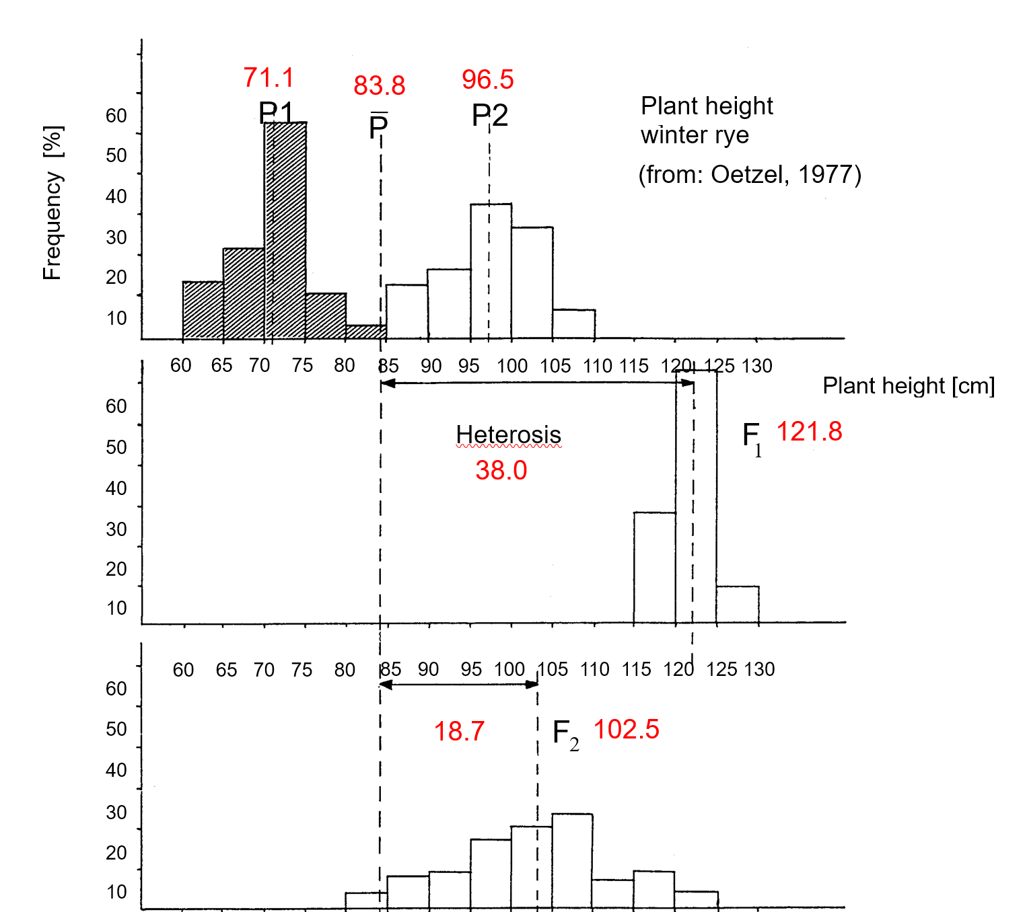
Generations Means Analyses based on experimental data from rye (Secale cereale)
Data from a polygenic trait, plant height, in the cross-fertilizing species Secale cereale. According to the Metric Model, the increase in plant height from parental mean to F1 is described by the addition of the domi-nance effects of the trait-’controlling’ loci; ‘c+d’ for F1 instead of ‘c’ for the parental mean. F2-mean is c + ½ d (summing across loci). The model’s data fits well to the finding (18.7cm is about ½ ∙ 38.0 cm).
The variation among the P1 and among the P2 plants et cetera is due to experimental error & (micro-) environ-ment impact. This variance seems higher in the homo-zygous parents than in the (more vigorous) F1. The vari-ation within F2 is very large. That variation is the sum of error, (micro-)environmental impact and genetic variance from segregation. One could test whether the variance in F2 was significantly higher than in the non-segrega-ting generations, checking for genetic segregation in F2.
The variances in non-segregating generations as ‘check’ minus the variance in F2 allows to ~separate the genetic share in F2 from its non-genetic share.
Frequency [%]
Heterosis
14

Slide 15
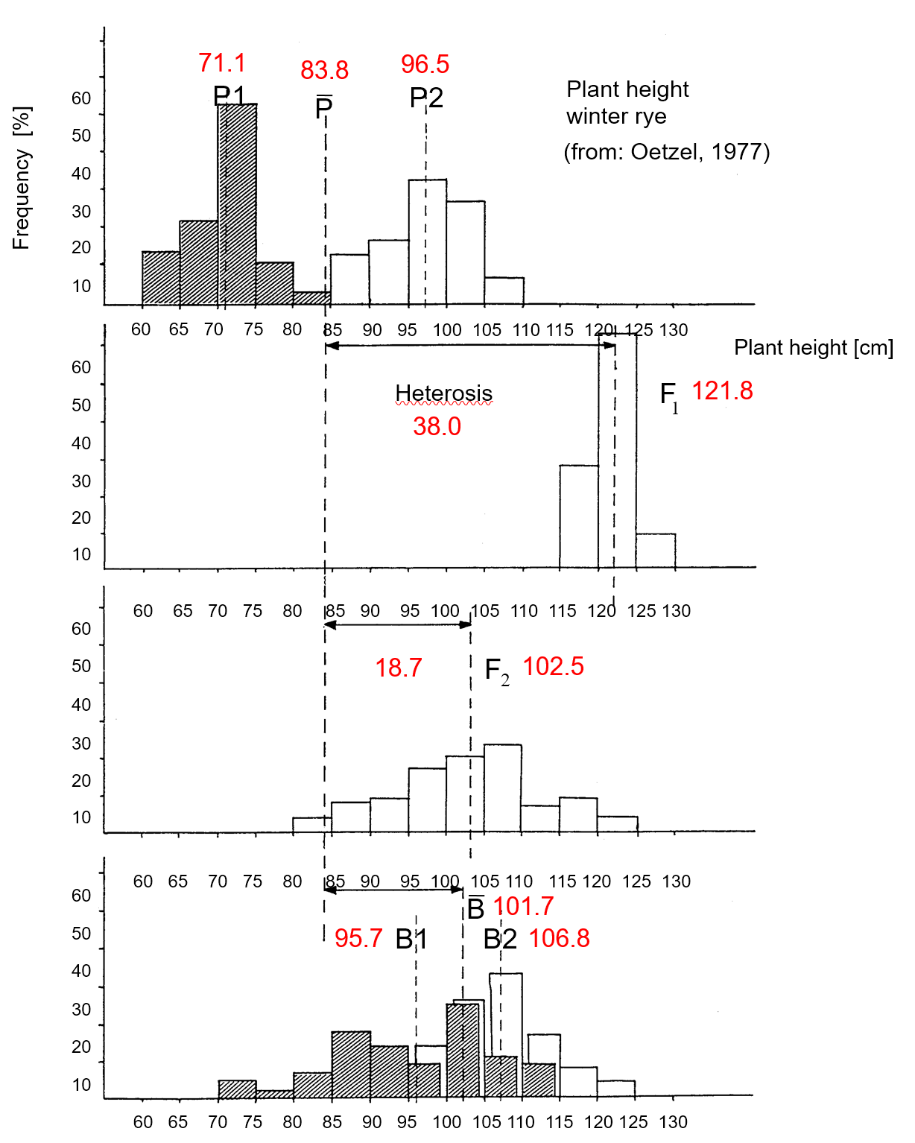

Generations Means Analyses based on experimental data from rye
As seen above, the expectation for the average value of the two back-crosses B1 and B2 is the same as the expectation for the F2-generation.
Here, the experimental results does not contradict that expec-tation, the difference between the 102.5cm average plant height of the F2-plants and 101.7cm average plant height of the two back-crosses is negligible and statistically not significantly different from zero.
Of course: This does not prove that biology works according to the Algebra of the F∞ model. It just says that, so far so good, the Metric Model allows reasonable predictions and may be a simple, useful tool.
Plant height
winter rye
Frequency [%]
‚A useful tool‘
15

Slide 16
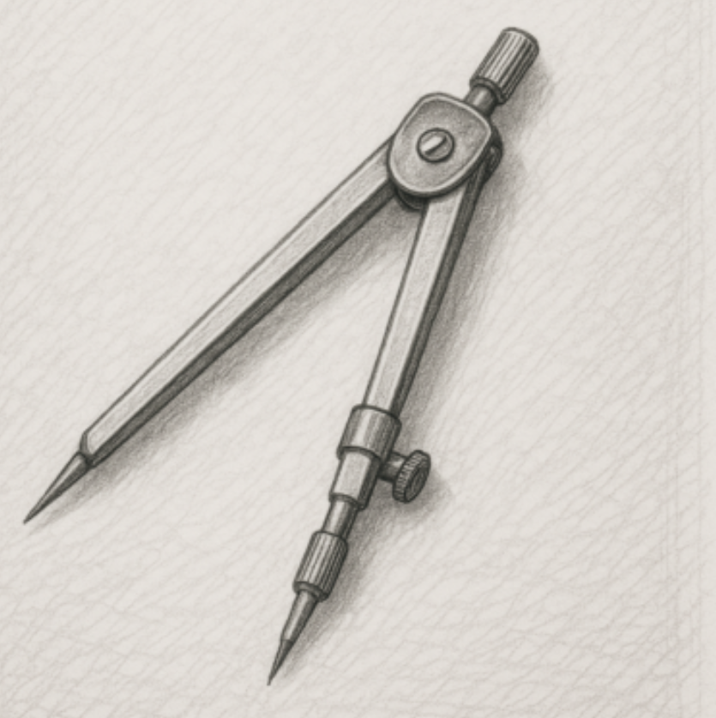
Generations Means Analyses based on experimental data from rye
The diagram covers the two backcross generations. You can decide for yourself whether you would expect greater or lesser variation between the individual plants within B1 or within B2 (or if taking the two together) … when you compare this with the variance between the individual plants in the generation F2.
You see the dramatic difference between the discussion of a genetic model, where we assume ‘true’ genetic values ... and experimental data.
In experimental data, the mean per generation is only an estimate of the true value and suffers from experimental error. What would we expect to see if having analysed the RIL generation (F∞)? Which genetic conditions and facts would rather increase or decrease this variance? We come to these points later again.
Plant height
winter rye
Frequency [%]
‚A useful tool‘
16

Slide 17
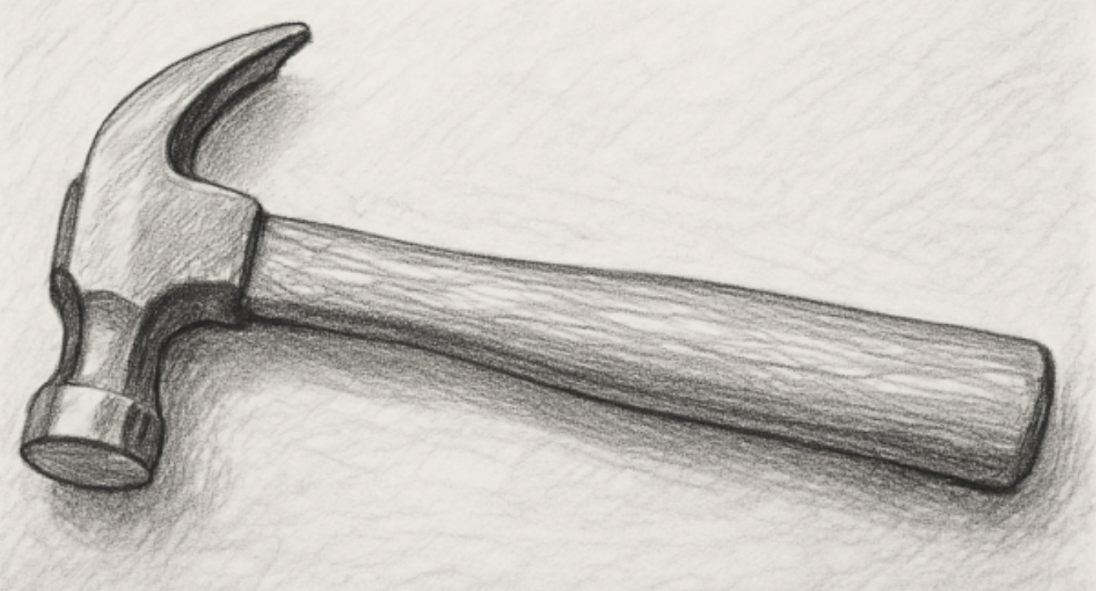
Generations Means Analyses based on experimental data from rye
Since the Metric Model was launched, very many experiments have shown that it predicts the values of these generations quite well, even in case of obviously polygenic traits. At first glance, this seems to imply that there is little or no epistasis. Yet, summing up across loci, positive and negative effects of epistasis among the trait-controlling pairs-of-loci may more or less cancel out each other.
Therefore:
Not finding major deviation from the model in polygenic traits (e.g. if F2 is not deviating from the mean of the two backcrosses) ... this is not disproving the existence and importance of epistasis!
Yet, it shows that the model, as simple and dull as it is, is able to make meaningful predictions and is thus a useful tool for Plant Breeding and Selection.
Plant height
winter rye
Frequency [%]
‚A useful tool‘
17

Slide 18
The Generations Means Analyses with parameters for pairs of loci (epistasis)
18
Here you see how epistatic effects may impact Generation Means. The minimum number of loci is used here: N=2. The parent P1 has both of the ‘capital-letter’ allele. Therefore, see below, P1 and P2, both realize +(aa)₁₂; this does neither imply that this (aa)₁₂ effect is large or exists at all - nor that it is positive. It may be positive or negative. Anyway, oftentimes a positive impact such as on resistance or on plant height is a negative impact on plant susceptibility and plant shortness ;-)
cf. UNPLAB-PopGen_Ch-9[LD I]. Page 14 ff.
*
*
Remember: We have seen this table recently.
L2: B|b | Locus1: A|a
 | AA | Aa | aa
BB | c+a₁+a₂+(aa)₁₂ | c+d₁+a₂ +(da)₁₂ | c-a₁+a₂-(aa)₁₂
Bb | c+d₂+a₁ +(ad)₁₂ | c+d₁+d₂+(dd)₁₂ | c+-a₁+d₂ -(ad)₁₂
bb | c+a₁-a₂-(aa)₁₂ | c+d₁-a₂ -(da)₁₂ | c-a₁-a₂+(aa)₁₂

Slide 19
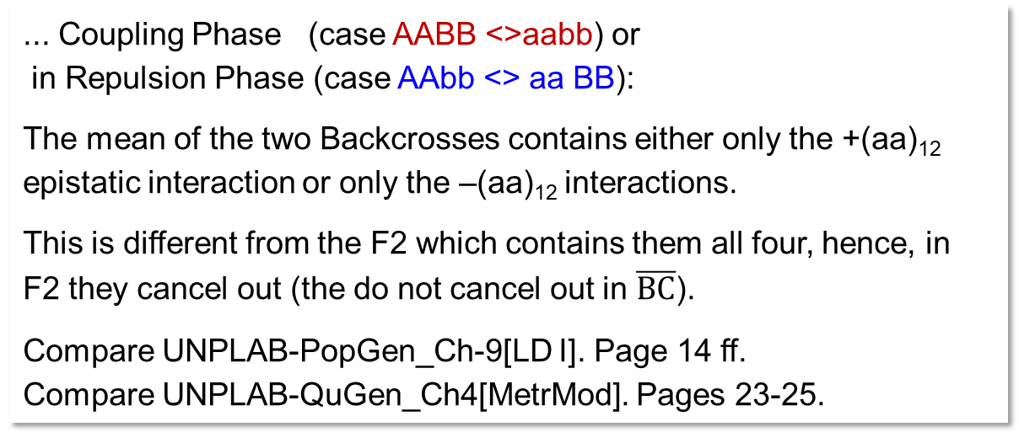
Compare F2 with the mean of the two Backcrosses. Check whether parents were in ...
... Coupling Phase (case AABB <>aabb) or
in Repulsion Phase (case AAbb <> aa BB):
The mean of the two Backcrosses contains either only the +(aa)₁₂ epistatic interaction or only the –(aa)₁₂ interactions.
This is different from the F2 which contains them all four, hence, in F2 they cancel out (the do not cancel out in $\overline{BC}$).
Compare UNPLAB-PopGen_Ch-9[LD I]. Page 14 ff.
Compare UNPLAB-QuGen_Ch4[MetrMod]. Pages 23-25.
19

Slide 20
The Generations Means Analyses with parameters for pairs of loci (epistasis)
The reference level ‘c’ for all parameters is the average of the generation F∞. Only in case of no epistasis, and F∞ are identical.
Heterosis: F1 – = d₁ + d₂ – (aa)₁₂ + (dd)₁₂
The extent of heterosis depends on the size of the dominance deviations (d₁+d₂); and additionally on the (aa) and (dd) Epistatic effects. In case of no Epistasis, there is a linear relationship across these generations between mean genotypic value of a generation and its mean degree of heterozygosity.
Further pertinent comparisons of Generation Means:
Obviously, differences between generations may be used to experimentally estimate the size of (aa) and of (dd) et cetera.
20
F1s are never heterozygous at all loci, you know! But here, homozygous loci in F1 are dumb, mute, boring; we disregard them.
20

Slide 21
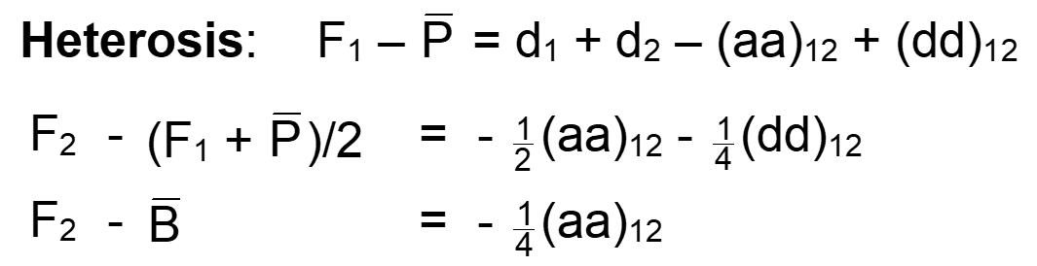
The Generations Means Analyses with parameters for pairs of loci (Epistasis)
DOI:10.13140/RG.2.2.17230.05440
21

Slide 22
Assume: Plant height of F2 is not at the ‘average of parent‘s means and F1’ (should be, if there was no epistasis). So, this is a hint on Epistasis for plant height. True?
P1
P2
F1
F2
Mean of F1
Mean of F2
Mean of P2
Mean of both parents
Mean of P1
Maybe, maybe not. The F2 individuals have the same genes as the F1 and as the sum of both parents, okay. And on average, they are half as heterozygous as the F1, okay. But. They grow in a heterogeneous, segregating field plot. The genetically shorter F2 individuals have genetically taller neighbours. In order to get enough light (competition), they will grow taller than they would if their neighbours were not that tall. The heterogeneity in F2 and the homogene-ity in P1, P2 and F1 may lead to a bias of this generation-comparison. The fact that F2 does not correspond to the ’average of parent’s mean and F1’ may reflect their heterogeneity rather than be caused by epistasis. Things are not always complicated; sometimes they are simple ;-)
22

Slide 23
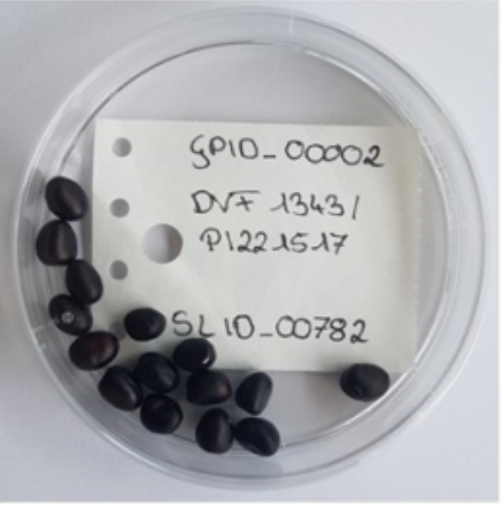
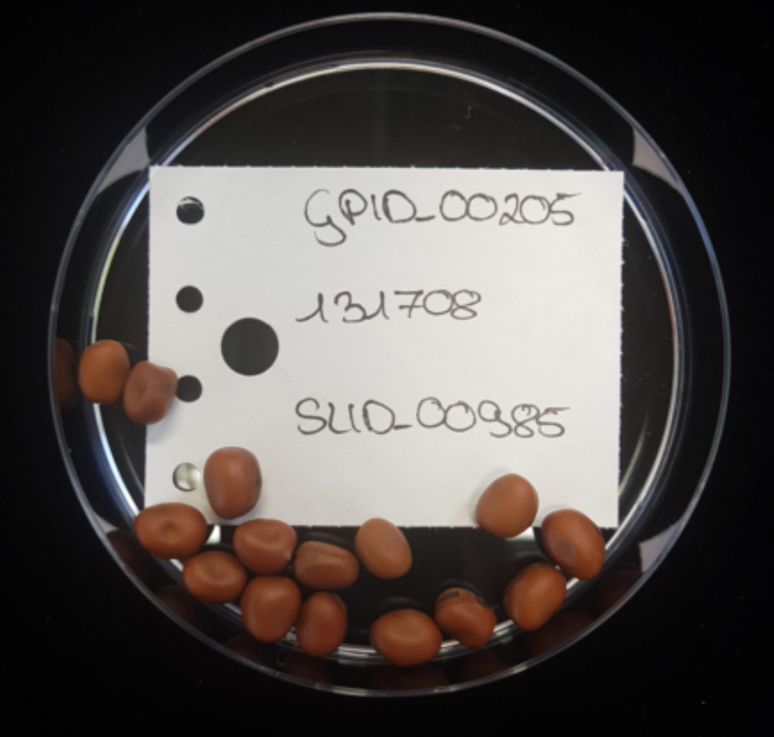
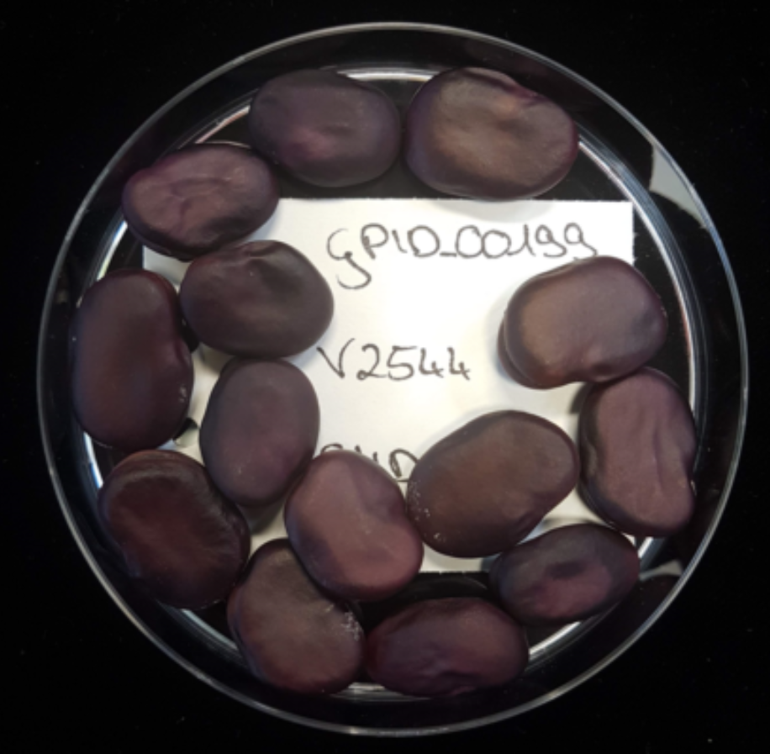
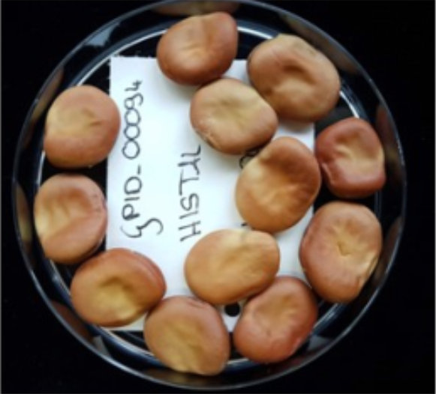
Metric Model explains Hete-rosis including Epistasis
► Assume a cross between an elite maize inbred line from - say - Uruguay with a good maize inbred line from - say - Estonia. It is obvious that genes that respond to day-length and temperature effects etc. are rather different between the parents. Sets of such genes are co-adapted within the Uruguay- and within the Estonia-germplasm (selected and fixed for ‚good‘ cooperation in these environments). In F1 and latest in F2, at a sudden, Estonia-genes must cooperate in the same metabolism with Uruguay-genes (we have even not yet specified whether offspring lives there or here or even somewhere else such as in Taiwan ☺☺☺). There will be advantageous epistatic effects fixed in the parents and then broken hence lost in the off-spring. Offspring will suffer from this loos (sometimes called ‚recombination loss‘, not ‘less recombination’ but loss of co-adapted groups-of-genes).
► Different example: If one parent has been bred to feed pigeons (‘tick bean’) and the other as vegetable (‘broad bean’): Then such extreme cross may lead to sudden in-crease in yield in F1 and later: Because the burdensome yield com-ponent restrictions are lifted. In our model we say ,yield-restricting, unfortunate, negative epistatic complexes are dissolved’ due to recombination.
23
© AW, ProFaba
cf DOI doi.org/10.1007/BF00223643
DOI:10.13140/RG.2.2.17230.05440
Tick bean, must be small!
23
Broad bean, must be large!

Slide 24
The Generations Means Analyses with parameters for pairs of loci (epistasis)
(F∞-metrik, no linkage)
Coupling
Repulsion
(Repulsion phase)
24
24

Slide 25
The Generations Means Analyses with parameters for pairs of loci (epistasis)
25
(F∞-metrik, no linkage)
Coupling
Repulsion
What we define as ‚Coupling‘ and as ‚Repulsion‘ is, in a different tradition of genetics, defined as: ► Parental gamete phase and Recombined (or Recombinant) gamete phase or as: ► parental and recombined (or recombinant) haplotype.

Slide 26
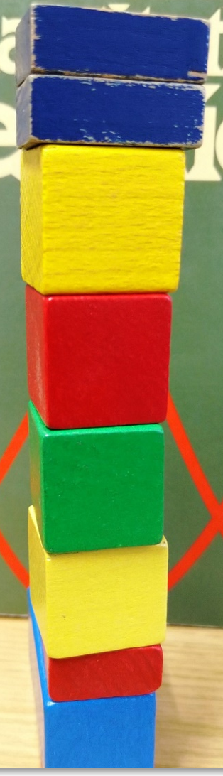
From here you may go to UNPLAB-QuGen_Ch-5[GenMeanAnal]
26

